Slide 1
Making this resource work for you
Prior to teaching this lesson, please refer to the ‘Unit Overview and Planning Document’.
Further guidance on planning Science Mastery lessons can be found in the detailed planning guidance document.
Refer to the ‘notes’ section on each slide for useful information, including suggested expositions, pedagogical content knowledge, suggested questions, answers and more. Consider using presenter mode so you can see this guidance throughout the lesson.
The introduction slides can be adapted to suit your teaching style and the needs of your class.
Before the lesson, adapt the fix-it slide to address any misconceptions identified in the previous lesson’s exit ticket.
Choose from the suggested activities to suit your class. The intention is not that you complete all of these, but that you select those which ones are most appropriate for your students. It may be appropriate to further adapt activities for your students.
These lessons are designed to occupy approximately 1 hour. To adapt for a shorter or longer lesson duration we advise you to adapt the activity section accordingly.
Please consider using the final slide to send feedback about this lesson or examples of PowerPoints that you have adapted to our design team. Your feedback is used to improve Science Mastery for all of our teachers and students. We appreciate all suggestions and comments.
Thank you for reading!
The Science Mastery Team

Slide 2
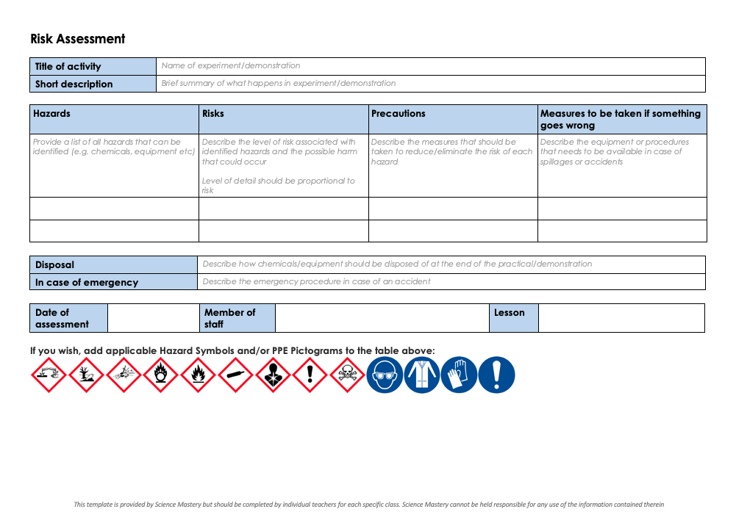
Practical Activity
This lesson contains a practical activity (either a whole class activity or a demonstration)
A risk assessment must be completed for this practical
The template risk assessment can be found here.
The risk assessment should be specific to the class involved and written only by the teaching member of staff
The risk assessment should refer to the current CLEAPSS Hazcards for all chemicals used in the practical for safety and disposal notes.
A list of chemicals used can be found in the Practical Guide
It is good practice for students to wear safety spectacles during all class practicals and demonstrations
Thank you for reading!
The Science Mastery Team

Slide 3
Growth of Bacteria
Answer the questions below.
Compare the sizes of eukaryotic and prokaryotic cells.
Describe the function of an inoculating loop.
Explain why the aseptic technique is used.
Name the type of cells that have genetic information stored in a nucleus.
Name the organelle that controls the entry and exit of substances into and out of cells.
Eukaryotic cells are typically between 1-100 μm, whereas prokaryotic cells are typically between 1-10 μm.
To transfer bacteria (or other microorganisms) to a medium.
To prevent contamination when preparing a culture.
Eukaryotic cells
Cell membrane
Notes:
Foundation: Where is the genetic material found in prokaryotic cells?
Stretch: Explain why prokaryotic cells have flagella.
Answers:
Foundation: Plasmid and the free DNA loop
Stretch: To allow them to move.

Slide 4

B3.1.4
21/10/2024
Growth of Bacteria
B3.1.1 Prior Knowledge Review
B3.1.2 Eukaryotic and Prokaryotic Cells
B3.1.3 Aseptic Technique
B3.1.4 Growth of Bacteria
B3.1.5 Microscopes
B3.1.6 Observing Cells
B3.1.7 Diffusion
B3.1.8 Diffusion in Living Things
B3.1.9 Osmosis
B3.1.10 Osmosis Investigation
B3.1.11 Active Transport
B3.1.12 Cell Division
B3.1.13 Cancer
B3.1.14 Stem Cells
Notes:
Big Idea: Cells are alive
In this lesson pupils will build on their knowledge of the aseptic technique by preparing a culture of bacteria. This will be further developed in Year 10, when students look at the effectiveness of antibiotics, and the dangers of antibiotic resistance.
Suggested Hook:
A good place to start may be asking pupils ‘in what scenarios would scientists need to grow bacteria?’ A good example would be when a patient is ill with an infectious disease and goes to the doctors. The doctors may take a sample (swab/urine/spittle) from the patient and send it to the lab where it is cultured so that bacteria grow and scientists can subsequently identify the bacteria present to prescribe the correct antibiotics.

Slide 5

Following this lesson, students will be able to:
State the steps involved in aseptic technique
Describe how to calculate how many bacteria are present in a culture from the mean division time
Prepare a culture sample using aseptic technique
Key Words:
aseptic
culture
agar medium
inoculating loop

Slide 6
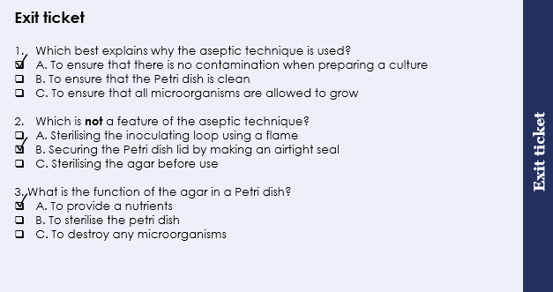
This is the fix-it portion of the lesson
The fix-it is an opportunity to respond to gaps in knowledge, especially those identified by the previous lesson’s exit ticket.
The teacher should customise this slide as needed, to facilitate
reteach, explanation, demonstration or modelling of ideas and concepts that students have not yet grasped or have misunderstood.
practise answering specific questions or of key skills.
redrafting or improving previous work.
Notes:
Purpose: to spend time on any gaps identified in previous learning from exit ticket feedback.
Answers:
Q1. Answer: A
If pupils answered B they have confused part of the aseptic technique with the reason for doing it.
Q2. Answer: B
If pupils answered A or C they have misconceptions around the aseptic technique.
Q3. Answer: A
If pupils answered B or C they have misconceptions around the aseptic technique
To fix it for any of these misconceptions it may help for pupils to write out their own method of the aseptic technique and to explain the rationale behind each step. You may also want get pupils to write a mnemonic to help them remember the steps involved. A task of matching the steps to reasons would also work. Remind pupils that the purpose of the activity today was to not grow any bacteria as the aseptic technique was being practised. Usually specific microorganisms would be cultured not none at all!

Slide 7
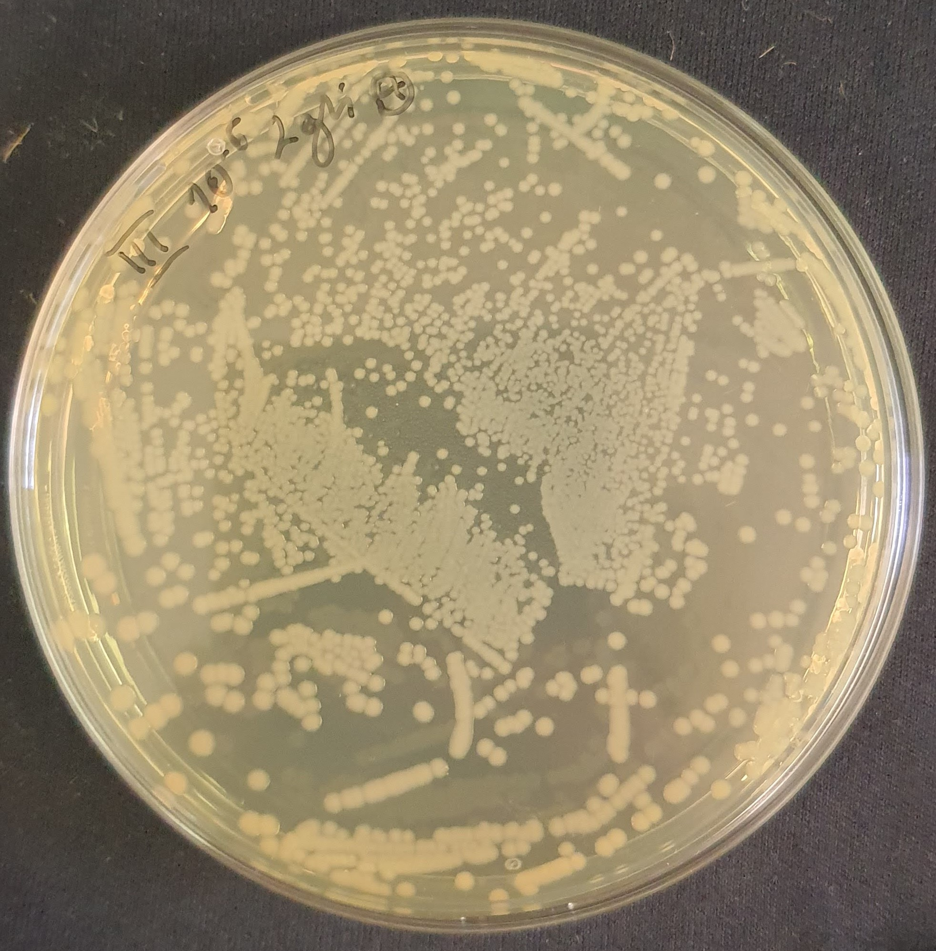
The Growth of Bacteria
Certain bacteria can cause diseases
In this practical, we are going to swab different areas to look at the bacteria found there
Notes:
Purpose: key information for this lesson, not residual knowledge but useful to explain the rationale behind it being a required practical.
Type of exposition: Explanation
Suggested script:
Some (not all) bacteria can cause infections. Bacteria that do this are known as pathogens. Some bacteria are only pathogenic (bad) in certain scenarios. For example, staphylococcus bacteria live on the surface of many peoples’ skin and cause no problems. However, if staph bacteria enter the blood stream they can cause blood poisoning (sepsis) which can be life threatening. This is the reason the we need to be careful when growing microorganisms- it can be very dangerous if we accidently culture pathogens. The aseptic technique is used to prevent pathogens growing wherever possible.
Antiseptics are chemicals that can kill bacteria. They are used in cleaning products including the sprays we use to clean the desks. Antibiotics on the other hand are drugs that treat bacterial infections inside the body. Antibiotics are only effective against bacterial infections and have no effect on viral or fungal infections.
Today we are going to investigate different locations in the lab/school to see how many and what types of microorganisms are found.
Possible opportunity to discuss with more able pupils examples of diseases caused by bacteria, or with the coronavirus pandemic why a virus could not be treated by antibiotics.
Image source:
CC@https://commons.m.wikimedia.org/wiki/File:Pseudomonas_gessardii_on_LB_agar.jpg

Slide 8
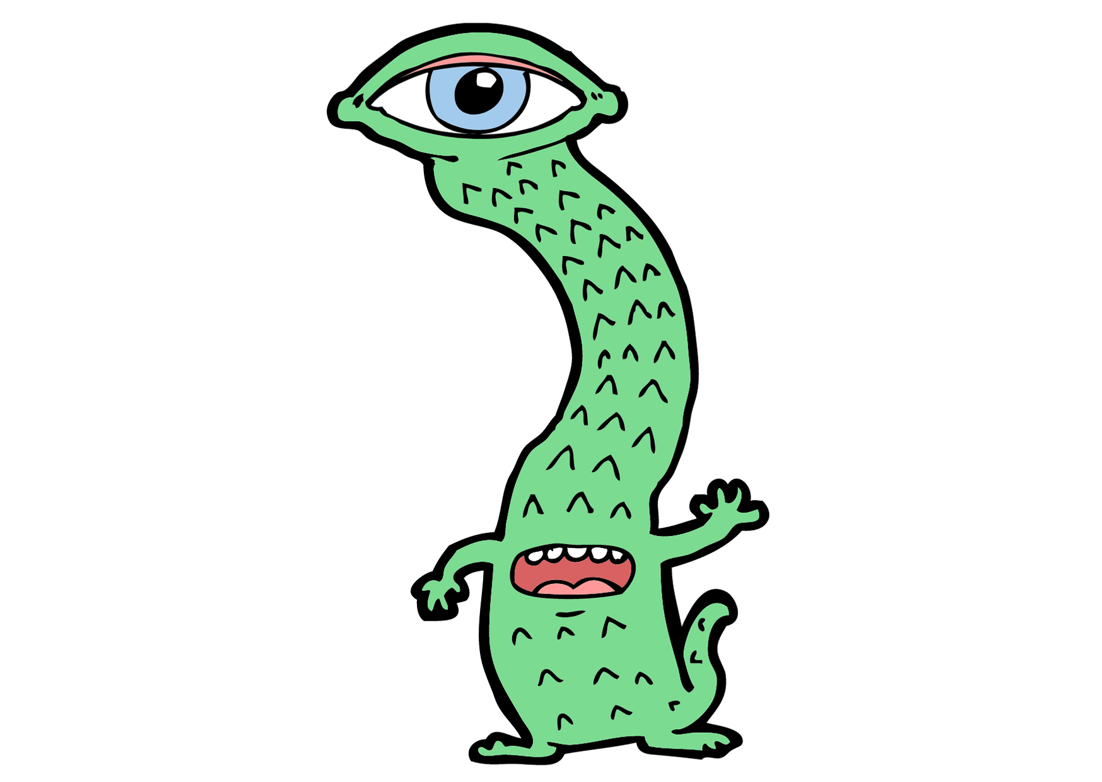
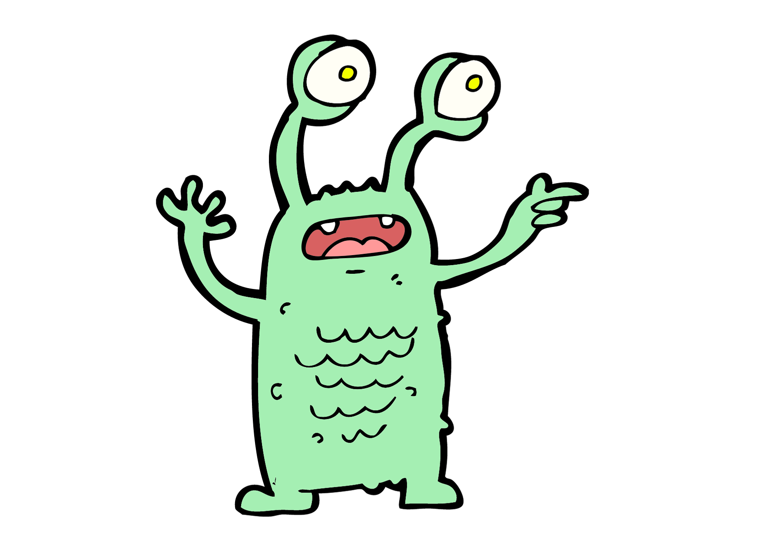
Out of this world!
How would you describe this process to an alien from space?
Aseptic technique
Notes:
Check understanding from previous lesson – you may then need to recap using next slide
Suggested guidance:
Talk tasks can be used in a variety of ways to suit the particular needs of the students you are teaching. Through exchanging views with others, students develop their understanding of the science beyond what could be achieved individually.
Science classrooms that successfully integrate talk have the following features:
Science talk is a regular feature of lessons and is woven into classroom activities.
Students are paired or grouped strategically by the teacher to ensure productive interaction. This might take into consideration the students’ proficiency of the English language, how encouraging they might be to peers and their attainment in the topic. It’s a good idea to consider these pairings in the class seating plan.
Students are encouraged and supported to talk, but are not forced to talk.
The teacher should take on the role of a facilitator, engaging with conversations where necessary and encouraging or steering the conversation where needed.
Students are encouraged to use the language they have to express their ideas (e.g., everyday language, imperfect English, native language), but also to incorporate science specific terminology where this is more accurate or has been taught.
6. Scientifically inaccurate ideas are not dismissed by the partner or teacher; open discussion and further investigation are relied on to help students construct ideas that support them to progress in their scientific understanding.
7. Guidelines for behaviour during talk tasks are explicit and frequently reviewed. Rules for students might be:
Listen carefully to your partner
Take turns talking.
Speak one at a time, without interrupting.
Politely agree or disagree and explain why.
Politely point out if your partner has used a scientific word incorrectly, if they have explained the science incorrectly, or if there is a more accurate way to describe something.
If confused, ask questions.
Stay focused on the discussion topic.
Respond to one another.

Slide 9
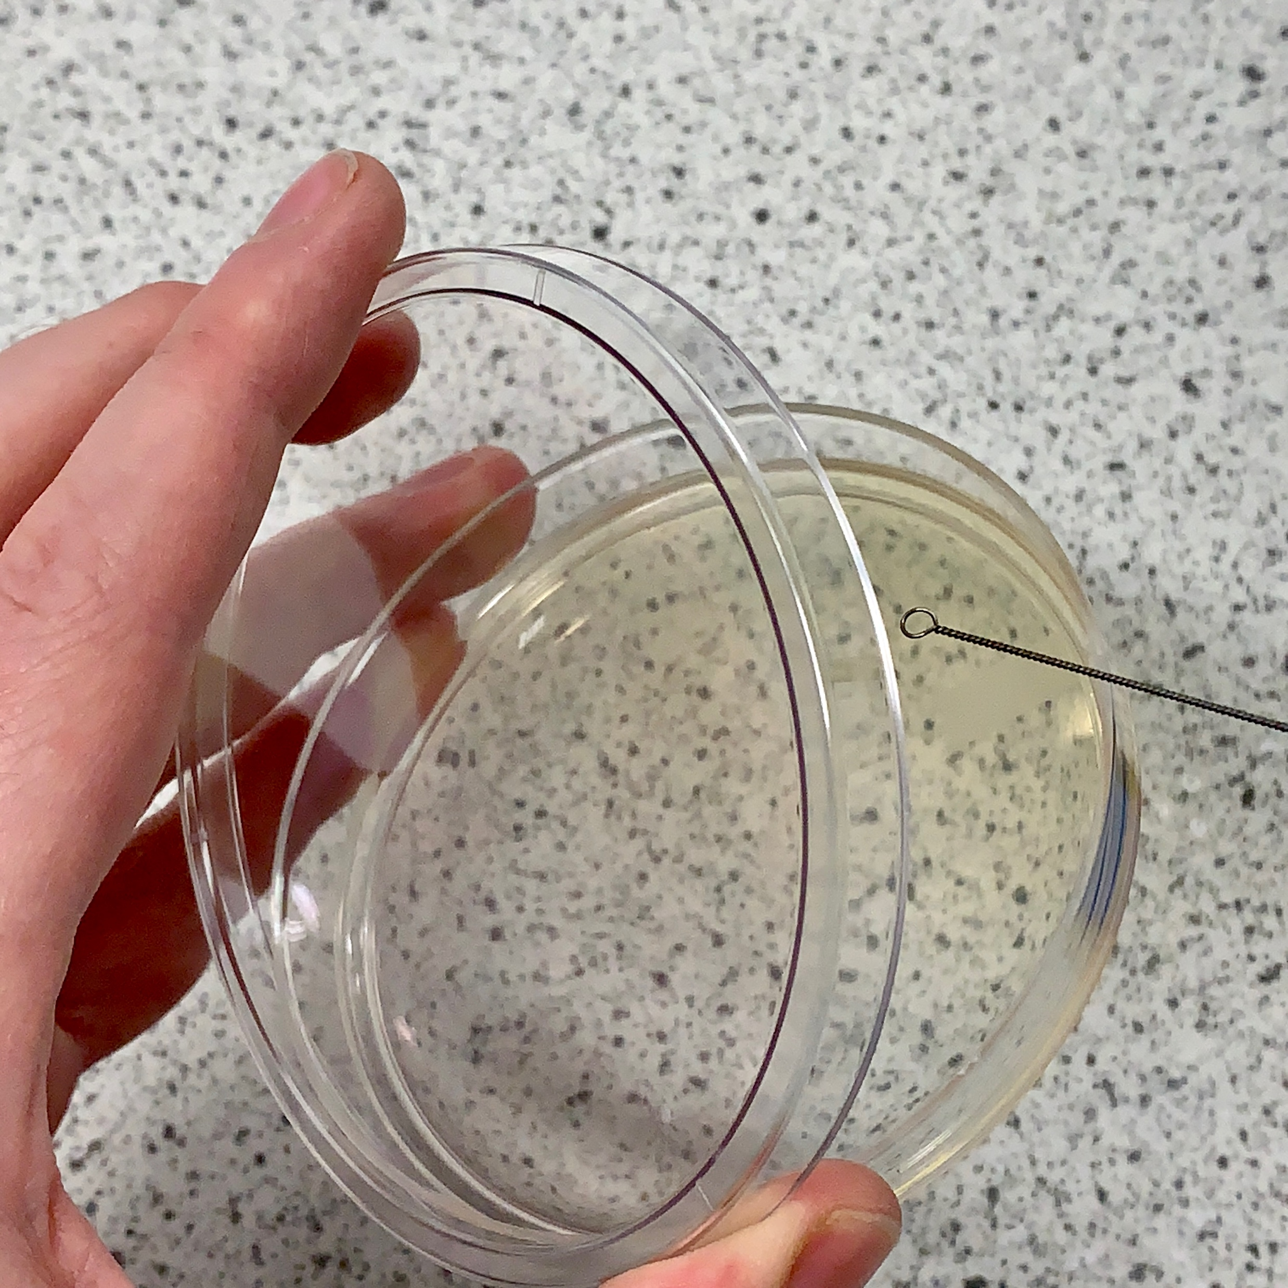
Aseptic Technique
Petri dishes and culture media (agar) must be sterilised before use
Agar medium in plates must be set
Inoculating loops are used to transfer the bacteria to the agar but must first be sterilised by passing them through a flame
The lid of the Petri dish should be secured with tape and stored upside down
In school laboratories the culture should be incubated at 25 °C.
Notes:
Type of exposition: Explanation/demonstration​
​
Suggested Script:​
To be safe only the intended type of microorganism should be grown in the petri dishes, therefore all equipment must be sterilised before use to kill and microorganisms that were present there before. This includes washing hands with soap, sterilising the work area with disinfectant, sterilising the air around the work area by lighting a Bunsen burner and sterilising all equipment intended to be used. Sterilising equipment involves heating it therefore the agar medium will need time to cool down and set- this must be done with the lid on to stop new microorganisms in the air from entering the Petri dish. In school the Petri dishes and agar plates have already been sterilised in the science prep room. ​
An inoculating loop is used to transfer microorganisms to the agar (hold up an inoculating loop). This must also be sterilised so is passed through the flame of a Bunsen burner immediately before use (turn a Bunsen flame to a roaring flame and hold the loop at the top of the flame for a few seconds). Why is this done? To kill any microorganisms already present on the inoculating loop. The inoculating loop is then dipped into the microorganism sample and carefully distributed across the agar plate. ​
(At this point demonstrate how to partly lift the lid of the petri dish (shown in picture) and how to streak the surface of the agar in a zig zag fashion without tearing it.)​
Once the sample is present on the agar, the lid of the petri dish needs to be secured down with tape upside down to ensure no contamination from other microorganisms while they incubate. Storing them upside down also reduces any condensation from developing in the petri dishes and means it will be easier to see any microorganisms once they have been cultured. The dishes are then left to incubate in an incubator at 25oC, this temperature allows the microorganisms to grow but reduces the risks of unwanted, dangerous microorganisms from growing. ​
​
​
Suggested guidance: Pupils will need to understand the reasoning for each part of the aseptic technique. Suggested questions below.​
Explain why:​ • Petri dishes and culture media must be sterilised before use – to kill any microorganisms that were already present​ • inoculating loops used to transfer microorganisms to the media must be sterilised by passing them through a flame – kills any bacteria present on the loop​ • the lid of the Petri dish should be secured with adhesive tape and stored upside down – stops contamination from microorganisms in the air​ • in school laboratories, cultures should generally be incubated at 25°C – to allow growth of the bacteria but minimise chance of growing unwanted pathogens ​
Agar medium is present to allow bacteria access to all required nutrients. ​

Slide 10
Quick Quiz
Choose the correct answer for each question:
What is the purpose of using the aseptic technique to prepare the petri dishes?
A. It ensures the growth of as many types of bacteria as possible
B. It ensures that only the bacteria we are investigating is allowed to grow
C. It ensures that no bacteria grow at all
What is in independent variable in our practical today?
A. The microorganisms found in different locations
B. The agar in the Petri dish
C. The level of contamination
✓
✓
Notes:
Purpose: assess understanding of new information. Answers in books or a discussion. Take consensus with answers and ensure no incorrect statements are accepted.

Slide 11
Growth of Bacteria
Bacteria are able to divide and multiply rapidly, which is often why they can cause diseases.
We can use their mean division time (how long it takes to undergo cell division) and how long the sample has been left to predict or calculate how many bacteria would be present.
Notes:
Type of exposition: Explanation
Suggested Script:
Bacteria increase in number by one cell doubling in size and then dividing into two – you will learn more about cell division in eukaryotes in a few lessons time. Bacteria multiply very fast, every time they reproduce the number doubles which enables them to spread very quickly. Different bacteria take different amounts of time to divide. We can use a species’ mean division time to calculate how many divisions the bacteria have gone through in a particular time period and therefore how many there may be.
Using the picture, if one bacterium goes through 2 rounds of division how many bacteria will be present? 4. If those 4 go through 2 ore divisions how many will there be? 16.
This kind of replication where the number of bacteria doubles with each reproduction is known as exponential growth.

Slide 12
Growth of Bacteria
Example:
Bacteria A has a mean division time of 30 minutes. If the culture begins with one bacterium how many bacteria would you expect to be present after 12 hours?
Calculate how many divisions would have occurred in this time.
12 hours/0.5 hours = 24 divisions.
Every time the bacteria reproduce, the number doubles. Now use this equation:
Final number of bacteria = Initial number of bacteria x 2^{number of divisions}
Final number = 1 x 2²⁴
= 16777216 bacteria (or 1.68 x10⁷ in standard form)
Notes:
Type of exposition: Modelling
Suggested Script:
Read out or ask a pupil to read out the question. The first thing we need to do is work out how many divisions there have been in this time period. We do this by dividing the time period by the mean division time in this case 12 hours/0.5 hours.
Misconception – often pupils will make a mistake on this calculation because they will not be using the same units (e.g. they will do 12 hrs/30 mins) – ensure pupils know that units must be standardised.
Every time the bacteria reproduce, the number doubles. To calculate the number of bacteria at the end of the growth period, you can use this equation.
Number of bacteria at the beginning = 1
Number of divisions = 24
1 × 2²⁴ = 1 × 16,777,216 = 16,777,216 bacteria will be present at the end

Slide 13
Growth of Bacteria
Now you try!
Bacteria Z has a mean division time of 15 minutes. If the culture begins with one bacterium how many bacteria would you expect to be present after 10 hours?
Calculate how many divisions would have occurred in this time.
10 hours/0.25 hours = 40 divisions.
Every time the bacteria reproduce, the number doubles. Now use this equation:
Final number of bacteria = Initial number of bacteria x 2^{number of divisions}
Final number = 1 x 2⁴⁰
= 1,099,511,627,776 bacteria (or 1.1 x10¹² in standard form)
Notes:
Misconception – often pupils will make a mistake on this calculation because they will not be using the same units (e.g. they will do 10 hrs/15 mins) – ensure pupils know that units must be standardised.

Slide 14
Drill
State which type of cell divides more rapidly, eukaryote or prokaryote?
A bacterium has a mean division time of 30 minutes. If the culture begins with one bacterium, how many divisions would have occurred in 10 hours?
Name the kind of replication where the number of bacteria doubles with each reproduction
Explain why the agar plate is incubated at 25ºC
State what bacterial infections are treated with
Explain why bacterial growth on an agar will eventually slow down
Notes:
Purpose: This is a knowledge drill. The purpose of this is to check that the critical knowledge is secure before pupils move onto independent practice.
Suggested guidance: There are a range of ways this could be done depending on time and ability range of the class:
Mini whiteboards
As full sentences in exercise books
As short answers in exercise books
In the pupil workbook
As pair talk
As cold call

Slide 15
Drill answers
Prokaryote
10 hours/0.5 hours = 20 divisions.
Exponential growth
To minimise the risk of dangerous microorganisms from growing
Antibiotics
The agar is depleted of nutrients
Notes:
Purpose: This is a knowledge drill. The purpose of this is to check that the critical knowledge is secure before pupils move onto independent practice.
Suggested guidance: There are a range of ways this could be done depending on time and ability range of the class:
Mini whiteboards
As full sentences in exercise books
As short answers in exercise books
In the pupil workbook
As pair talk
As cold call

Slide 16
I: Interpreting graphs of bacterial growth
Describe the growth of this bacterium.
Number of bacteria (x1000)
Model answer:
Between 2 and 17 hours, the growth of bacteria is exponential.
After 5 hours there are 2500 bacteria present and after 10 hours there are 5000 bacteria.
The number of bacterial cells doubles every 5 hours
After 17 hours, the number of bacterial cells plateaus.
Time (hours)

Slide 17
We: Interpreting graphs of bacterial growth
Explain why the number of bacteria increases rapidly between 2 hours and 17 hours.
Number of bacteria (x1000)
Model answer:
Exponential growth occurs, where the number of bacteria double every growth cycle
Because there are many nutrients available for the bacteria to grow
Time (hours)

Slide 18
You: Interpreting graphs of bacterial growth
Explain why the number of bacteria plateaus after 17 hours.
Number of bacteria (x1000)
Model answer:
The agar is depleted of nutrients which are required for the bacteria to grow, so less bacteria are growing
During this phase, the number of bacteria being produced is the same as the number dying so there is no overall growth in the number of bacterium
Time (hours)

Slide 19
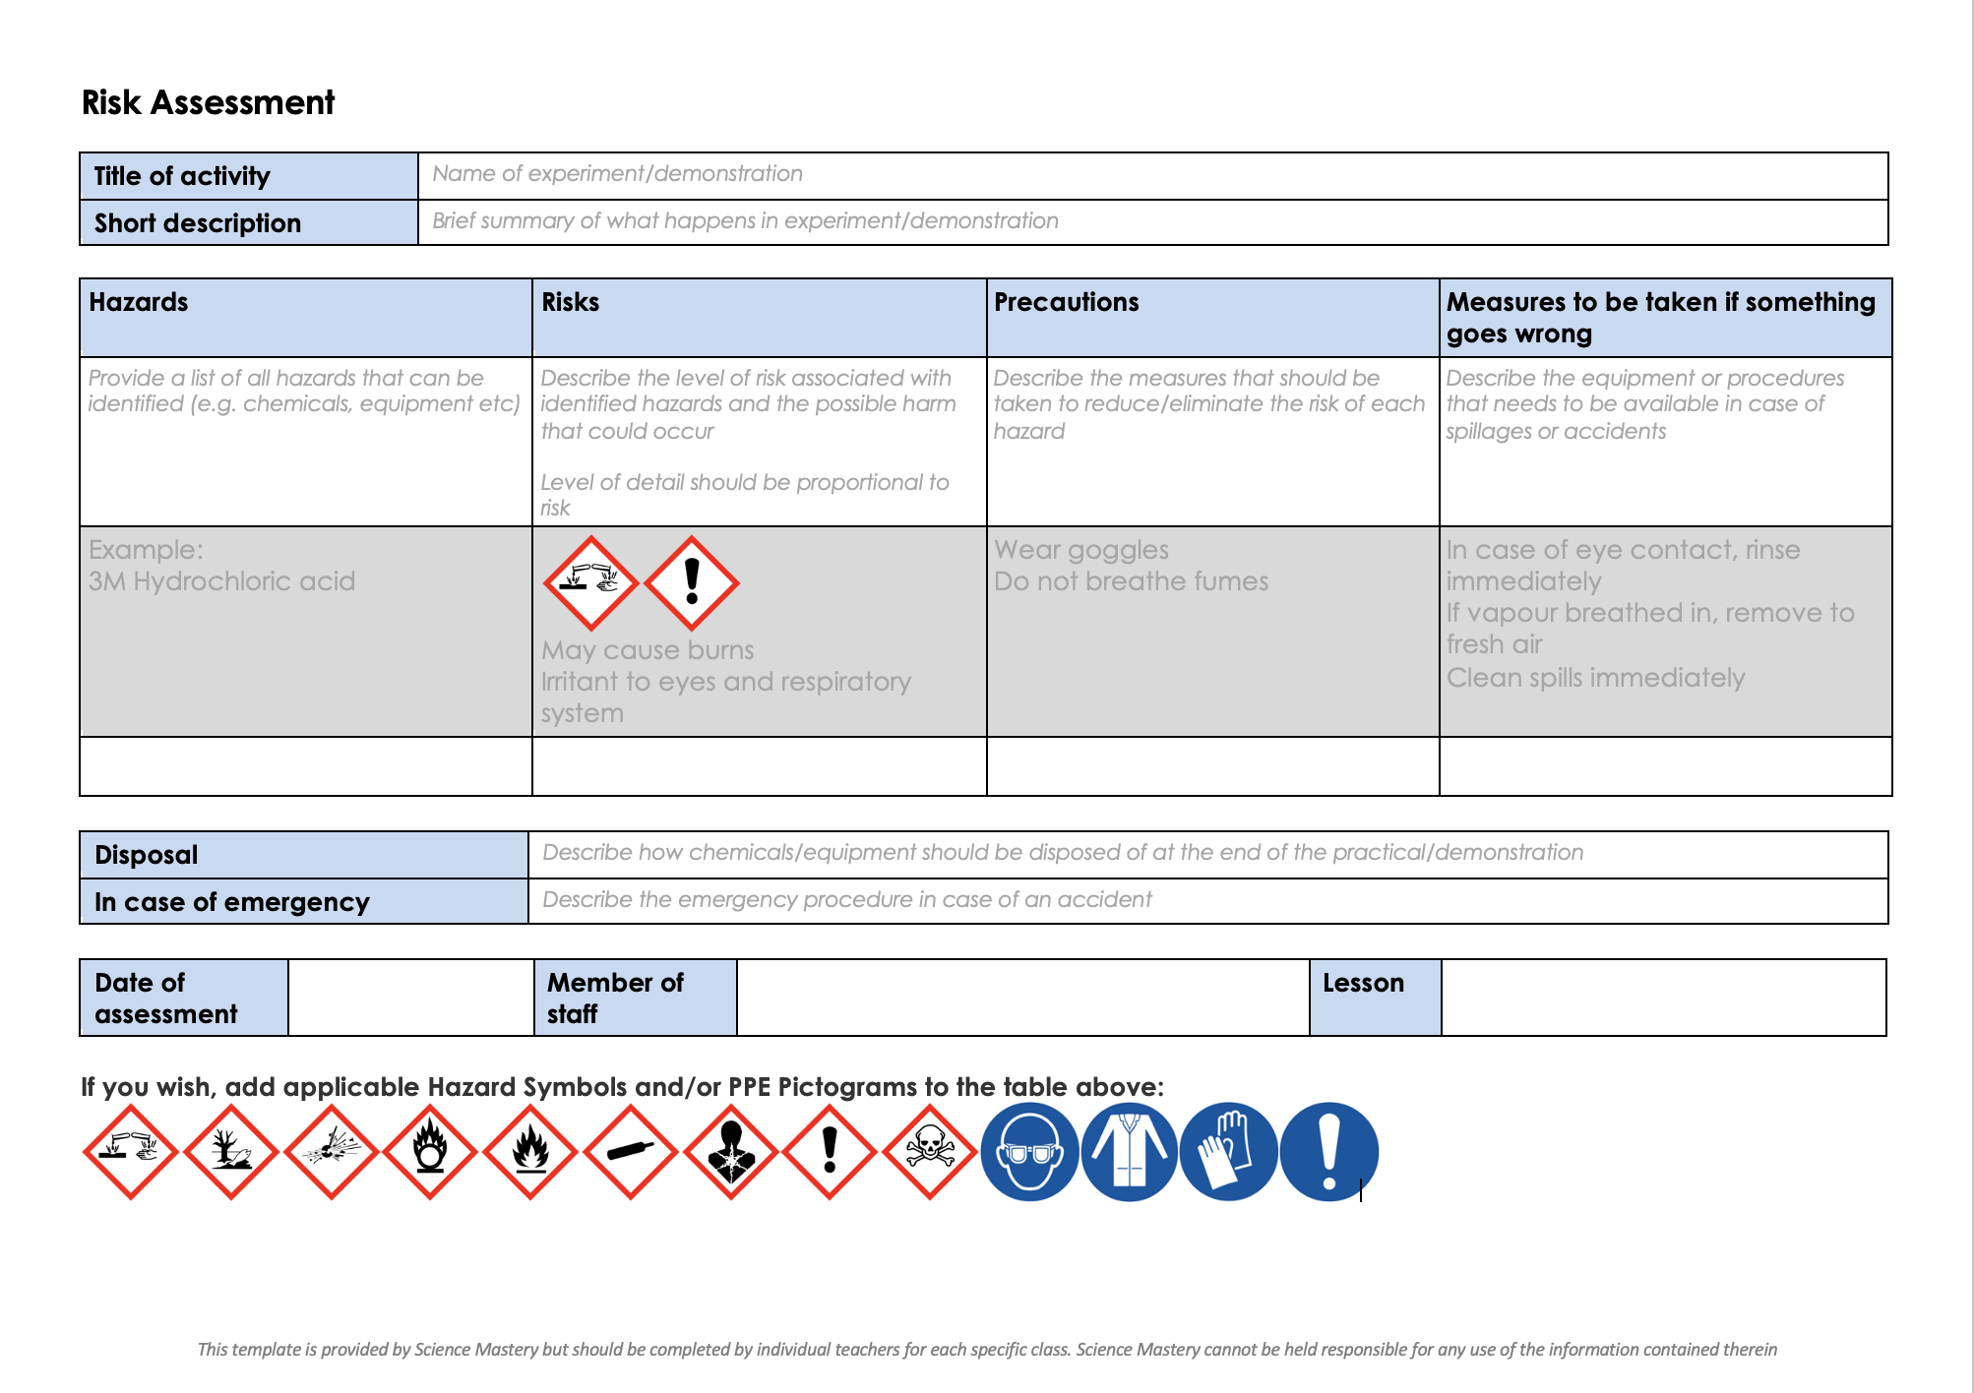
Risk Assessment
A risk assessment must be completed for this practical
The template risk assessment can be found here.

Slide 20
Growth of Bacteria Practical
Follow the instructions on the practical sheet to carry out the experiment and answer the questions.
Notes:
See practical guide
Allow pupils time to read through the method, using questioning to get pupils to understand the rationale behind sterilising the inoculating loop, taping the plate closed etc.

Slide 21
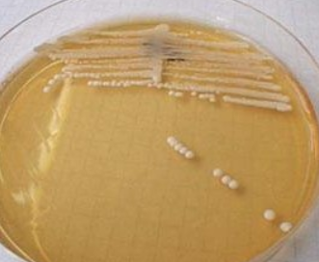
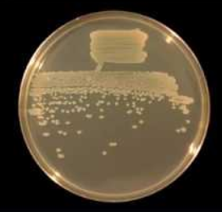
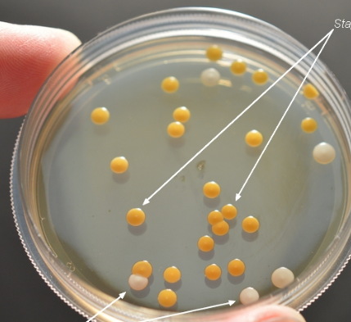
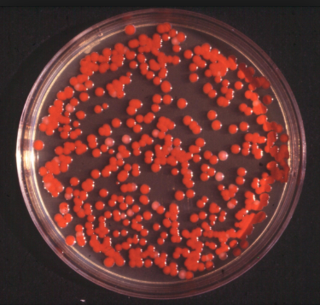
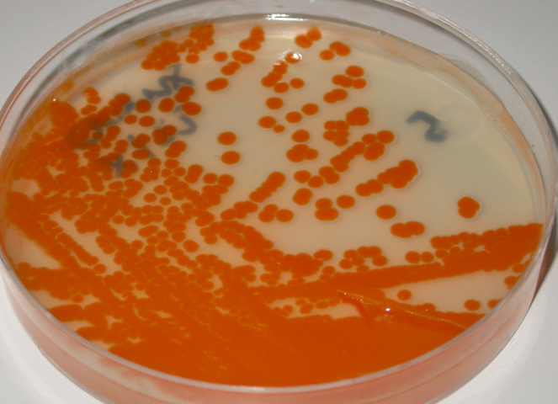
Common microorganisms
Use the following pictures to identify any of these common microorganisms on your agar plate.
Candida yeast (fungus)
Pseudomonas bacteria
Staphylococcus bacteria
Serratia bacteria
Streptococcus bacteria
Notes:
Guidance – there will probably be some fungal growth that looks white/grey and ‘fluffy’

Slide 22
Answer the questions below.
Which best explains the purpose of this investigation?
To look at how best to make bacteria grow to spread disease
To ensure no bacteria is allowed to grow
To determine the location with the most/fewest microorganisms
2. Which is a feature of the aseptic technique?
Ensuring there are no nutrients in the agar medium
Ensuring there is no contamination in the agar medium
Ensuring that oxygen is not allowed in to the agar medium
3. Why is the plate incubated at 25ºC?
To kill all bacteria
To minimise the risk of dangerous microorganisms from growing
Bacteria will not grow at lower temperatures
✓
✓
✓
Notes:
Purpose: to find out if students are able to answer key questions that check for understanding of the new information/skills that have been covered.
Suggested guidance:
Give students thinking time and then ask for feedback – either holding up fingers for the right number/letter, using mini whiteboards or just writing answers down in books quickly before cold calling.
Answers:
Q1. Answer: C
If pupils answer A or B they have not identified the aim. To fix it give pupils independent and dependent variables and ask them to write an aim from it.
Q2. Answer: B
If pupils answer A or C they are unsure on the aseptic technique. To fix it practice writing method for aseptic technique.
Q3. Answer: B
If pupils answer A they have not appreciated the purpose of the practical. To fix it ask pupils to identify the purpose and then discuss why answer A is wrong. If pupils have answered C they have the misconception that cold temperatures totally stop bacterial/microorganism growth. To fix this ask pupils to explain why food inside a fridge can still go bad/go mouldy. Cold temperatures do not kill bacteria or prevent growth they just slow the growth

Slide 23
Lesson B3.1.4
What was good about this lesson? | What can we do to improve this lesson?
Send us your feedback by clicking this link
or by emailing sciencemastery@arkonline.org
Thank you!

